Slide 1

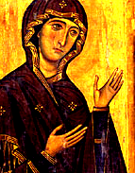
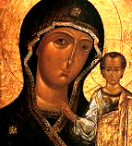
Blessed Virgin Mary: Model of Femininity
Dr. Mary Lemmons
Associate Professor of Philosophy
University of St. Thomas
St. Paul, MN

Slide 2

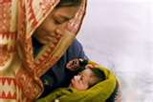

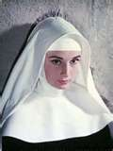





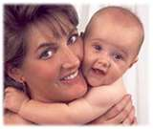

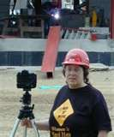

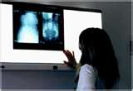

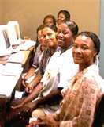
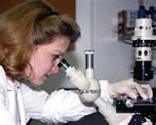



New Model or Exemplary Model?

Slide 3

How To Decide?
Who is the Blessed Virgin Mary—Really?
        Holy Scripture
Scripture Predicted Her Existence
  Genesis 3:15: “I will put enmities between thee and the woman . . .”
  Isaiah 7:14: “the virgin will be with child and bear a son and shall name him Immanuel . . .”
  Jeremiah 31:22:” The Lord has created a new thing upon the earth: the woman must encompass the man.”
  Micah 5:1-3: “But you Bethlehem . . . From you shall come forth for me one who is to be ruler in Israel . . . When she who is to give birth has borne . . .”
Scripture Records Her Deeds, Words and Significant Encounters
  Angel Gabriel and the Annunciation -- Last Words at Cana
  Visitation and the Magnificent -- Seeking the Adult Christ
  Nativity -- Standing at the Cross
  Presentation, Simeon, Anna -- Praying for Pentecost
  Fleeing into Egypt
  Seeking the adolescent Christ

Slide 4
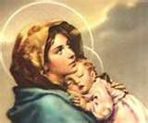
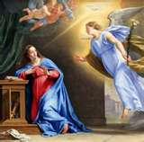
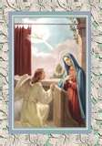
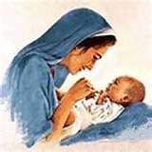
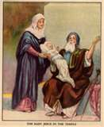
Holy Scripture Shows a Woman of Faith and Trust
Who Questions and Grows in Understanding
At the Annunciation, she questions the angel showing a firm understanding of human reproduction: “How can this be since I do not know man?” (Luke 1:34)
She resolves her doubt with trust and acceptance of her mission: “Behold I am the handmaiden of the Lord. May it be done to me according to thy word.” (Luke 1:38)
Yet she remained philosophical; thus the words of Simeon at the presentation filled her with amazement and wonder. Her son would be “a light of revelation to the Gentiles and glory for your people Israel.” (Luke 2:33)

Slide 5
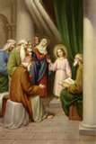
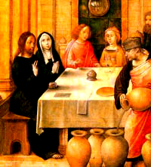
Our Lady did not automatically understand her son. She neither anticipated him staying behind the Caravan to teach in the Temple when he was twelve nor did she understand his response to her query: “Son, why have you done so to us? Behold your father and I have sought thee sorrowing.” (Luke 2:47-50).
But Mary loved too much not to seek deeper understanding of her son; she pondered these things in her heart. (Luke 2:50).
And she came to understand him and his mission. By the time of the marriage feast at Cana, she was very confident in her son’s mission --- so confident that she asked him to remedy the shortage of wine and uttered her last recorded words: “Do whatever he tells you.” (John 2:3-5.)

Slide 6


Cana was his first public miracle.
His disciples had begun to believe.
Our Lady had launched her son.
Did she think that her job was done?
She had reared not only a man but the perfect man filled with love, determination, intelligence, and religious zeal. She now knew his heart.

Slide 7

But then Christ threw a curve ball.
He called her “woman.”
Not Mom.

Slide 8
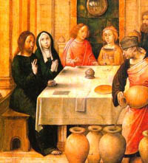
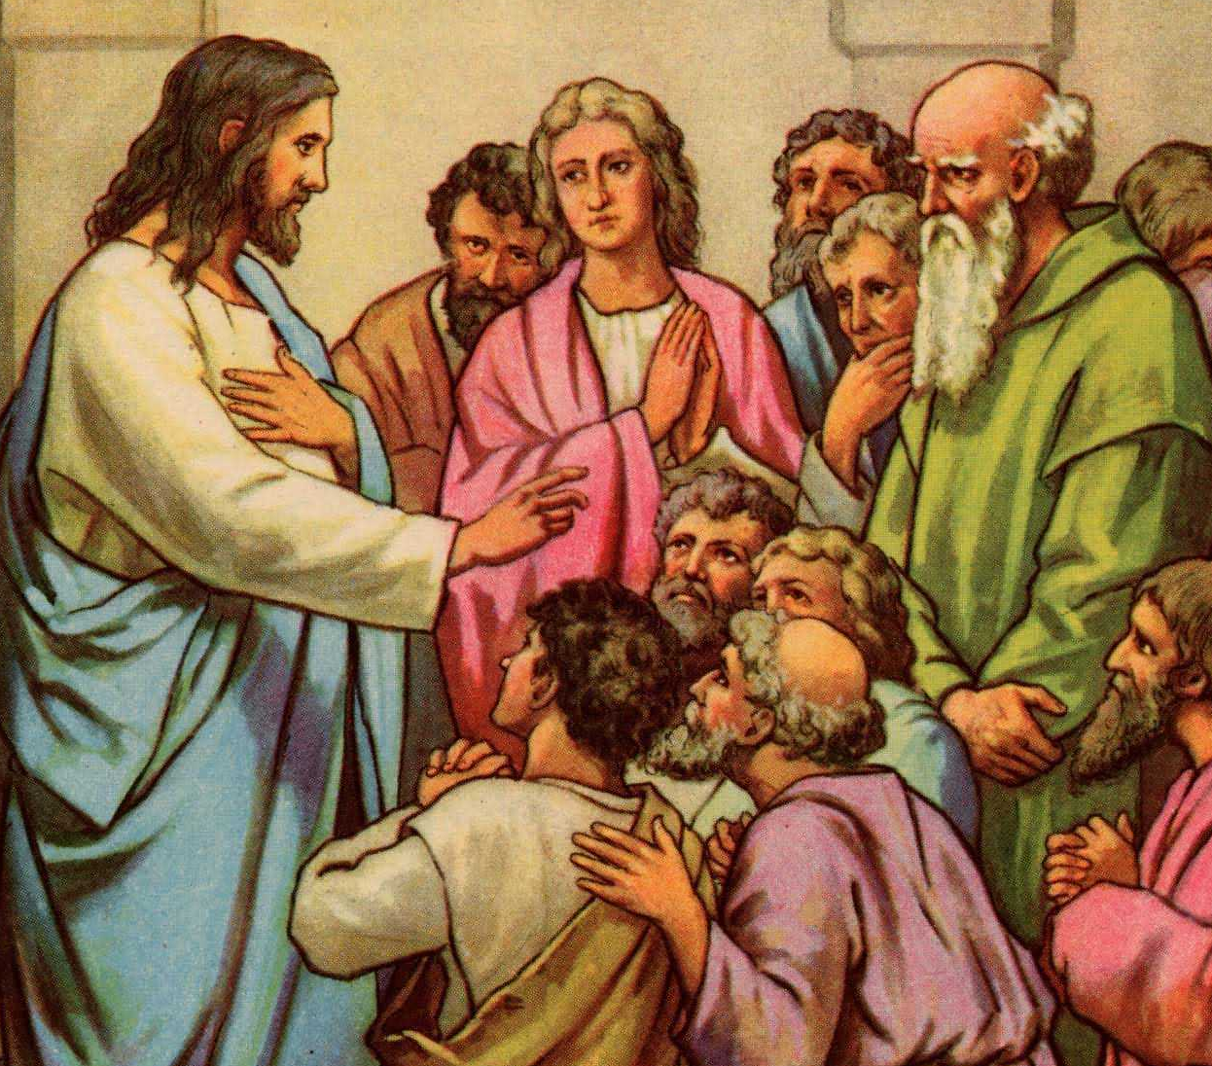
Filial Mysteries
        Why did Christ preface his very first miracle by responding to his mother’s request by addressing her as woman and asking her as John Paul II put it in his General Audience of February 26, 1997 (cited p. 174 in Theotokos) :*
        “O, woman what have you to do with me?”
Why did Christ---rather than ordering the crowd
to make way for his mother---ask
“Who is my mother,
and who are my brethren?” Matt. 12:48
Why did Christ answer his own question by saying:
“My mother and my brethren are those who hear
The word of God and act on it.” Luke 8:20
Was this a tacit invitation to every woman to exercise spiritual motherhood?

Slide 9
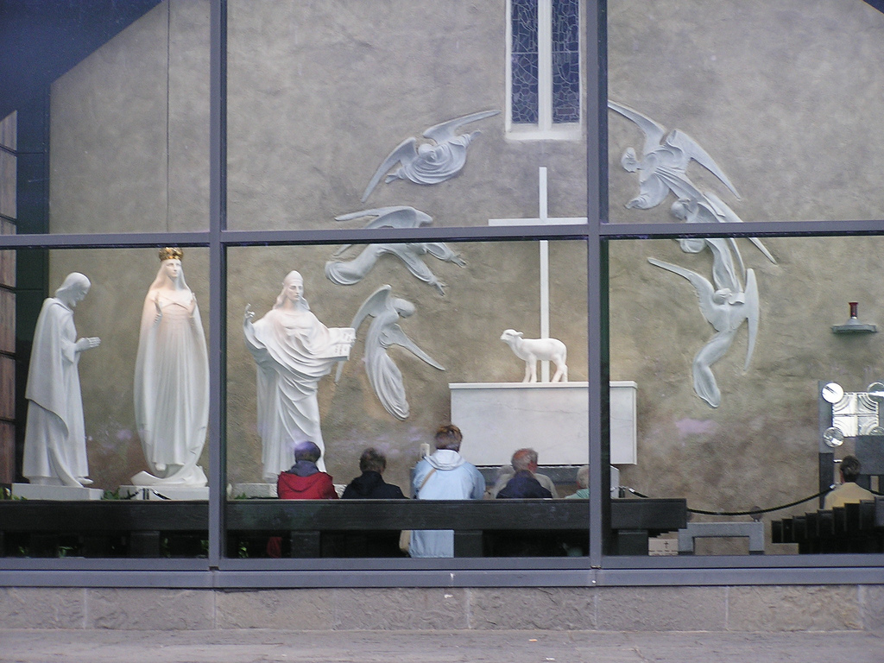
John Paul II’s Answer:
Mary’s Transcendence of Biological Motherhood and Her Spiritual Maternity as Cooperator in Salvation.
At Cana, Christ was asking his mom to be more than his biological mother but to become The Woman, The New Eve.
  As John Paul II put it: “Mary is associated as a woman in the work of salvation. Having created man ‘male and female’ (cf. Gn 1:27), the Lord also wants to place the New Eve beside the New Adam in the redemption. Our first parents had chosen the way of sin as a couple; a new pair, the Son of God with his Mother’s cooperation, would reestablish the human race in its original dignity. Mary, the New Eve, thus becomes the perfect icon of the Church.” (General Audience of April 9, 1997 cited p. 186 Theotokos)
Our Lady of Knock, Ireland

Slide 10
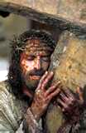
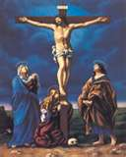
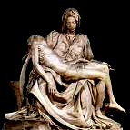
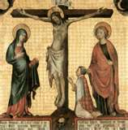

But First Calvary and the Pangs of Birth:
God’s way not ours
The Blessed Virgin Mary stood beneath the Cross: to be as supportive as possible. His mission was now hers.
She would henceforth define her very existence in terms of this mission. But her existence is feminine, since John Paul II defines sex in terms of existence.
But how could she, a woman, take on the mission of Christ?
Christ answered her heart’s quest: “Woman, behold thy son.” John 19:26.
At this moment, Mary’s maternity extended to John and to each of us.
She became our spiritual mother as Christ said, “Behold Your Mother.” Jn 19:27
Faith in her son and his resurrection never faltered. Lumen Gentium n. 62)

Slide 11
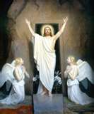

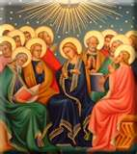
The depth of Our Lady’s love for each of us can be found in her post-Resurrection prayers for the coming of the Holy Spirit.
As John Paul II pointed out,* it was the coming of the Holy Spirit that confirmed Our Lady’s spiritual motherhood and established the Church. She is now the Mother of the Church.** (Theotokos *198; **233-5)

Slide 12
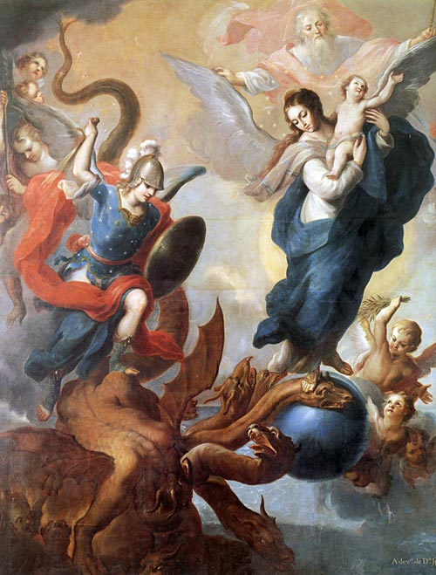
Our Lady experiences her spiritual motherhood as a war with the Devil
“I will put enmities between thee and the woman, and thy seed and her seed; s/he shall crush thy head and thou shalt lie in wait for her heel.” Genesis 3:15
“And a great sign appeared in heaven: a woman clothed with the sun, and the moon under her feet, and on her head was a crown of twelve stars; and being with child, she cried travailing in birth . . . And there was . . . A great red dragon . . . And his tail drew the third part of the stars of heaven; and cast them to the earth; and the dragon stood before the woman who was ready to be delivered; . . . That he might devour her son. And she brought forth a man child, who was to rule all nations with an iron rod; and her son was taken up to God, and to his throne.” Apocalypse 12: 1-16.

Slide 13
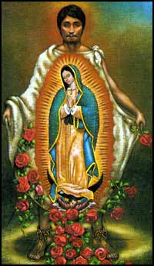
Here is another Scriptural passage that has been linked with the only known self-portrait painted by Our Lady Herself in 1231.

Slide 14
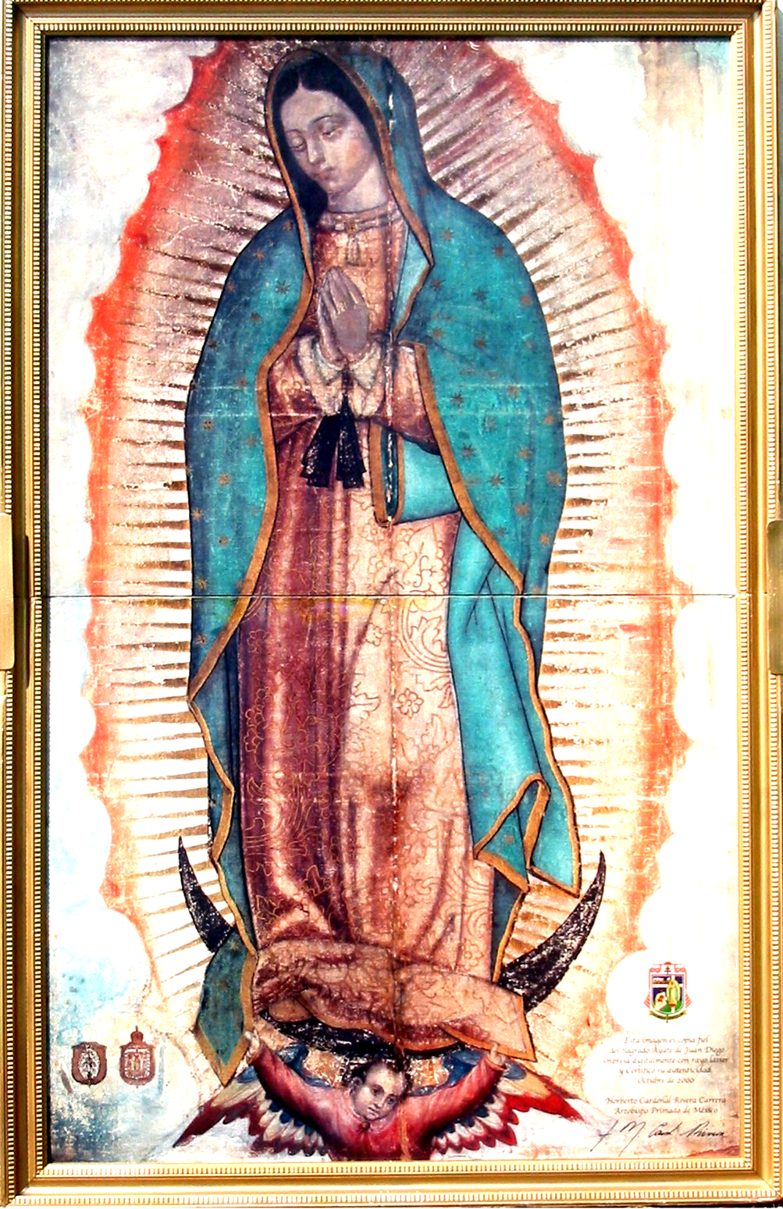
Canticle of Canticles 6:9: “Who is she that cometh forth as the morning rising, fair as the moon, bright as the sun, terrible as an army set in array?
The Virgin of Guadalupe:
The Warrior Mother
The Patroness of the Americas
What are her weapons?
1) Truth, the whole truth and nothing but the truth (her self-portrait teaches about Christ and thereby about human beings, since Christ reveals man to himself. Gaudium et Spes 22)
2) Deeply personal love for Christ, me and you.
3)Prayer and the Bestowal of Abundant Grace.
“Am I not your mother? Are you not under my shadow and my gaze? Am I not the source of your joy? Are you not sheltered underneath my mantle, under the embrace of my arms?”
(Nican Mopohua, nos. 118-119 cited by Benedict XVI in Brazil 13 May 2007).

Slide 15
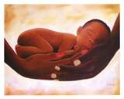

The Virgin Mother’s On-going Maternity
        “The maternity of Mary . . . is a gift that Christ makes
        to each man personally.” Ratzinger Mary p. 57
“In the Blessed Virgin the figure of “woman” is rehabilitated and her motherhood takes up the task of spreading the new life in Christ among men.” John Paul II, General Audience of April 23, 1997 cited p. 190 in Theotokos.
“We believe that the most holy Mother of God, the New Eve, the Mother of the Church, continues in heaven her motherly task for Christ’s members through her cooperation in the birth and formation of divine life in the souls of the redeemed.” no. 47.
“New birth from above is needed, rebirth of water and the Spirit (Jn 3:5) . . . To become a Christian means to be brought into this new beginning. . . . The transformation . . . Has the radical character of a real birth . . . But this means that the Virgin Mother is, once again, at the center of the event of redemption. With her whole being she guarantees the new thing God has done.” Ratzinger Mary p. 93
Pope John Paul II’s “fundamental claim is that the originality of Mary’s role of mediation consists in its maternal character, which aligns it with Christ’s being born ever anew in the world. It maintains the presence of the feminine dimension of the event of salvation, whose permanent center it is.” Joseph Cardinal Ratzinger, Mary: The Church at the Source p. 55

Slide 16
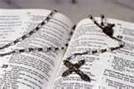
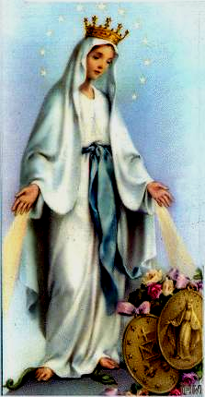
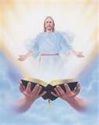
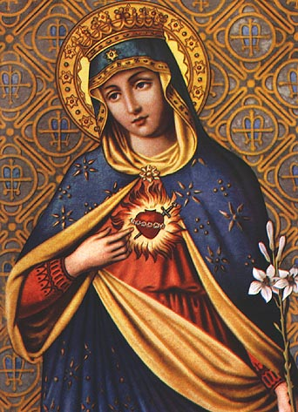
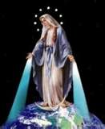
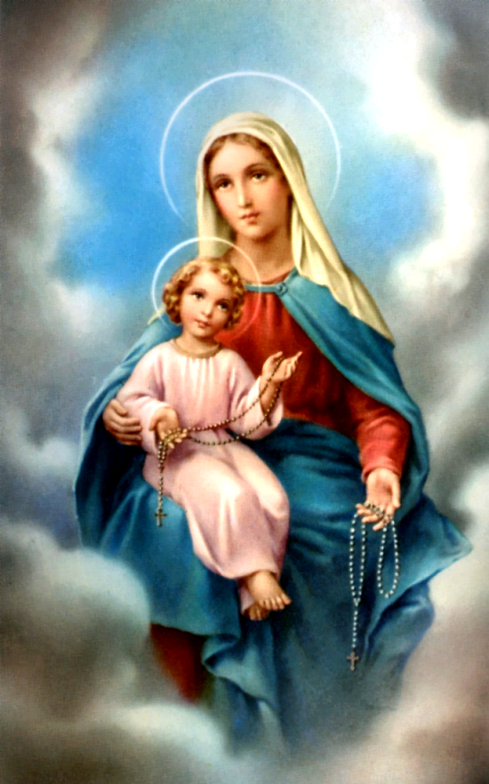
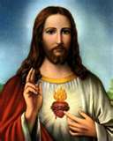
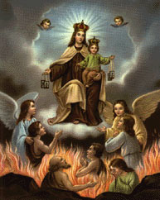

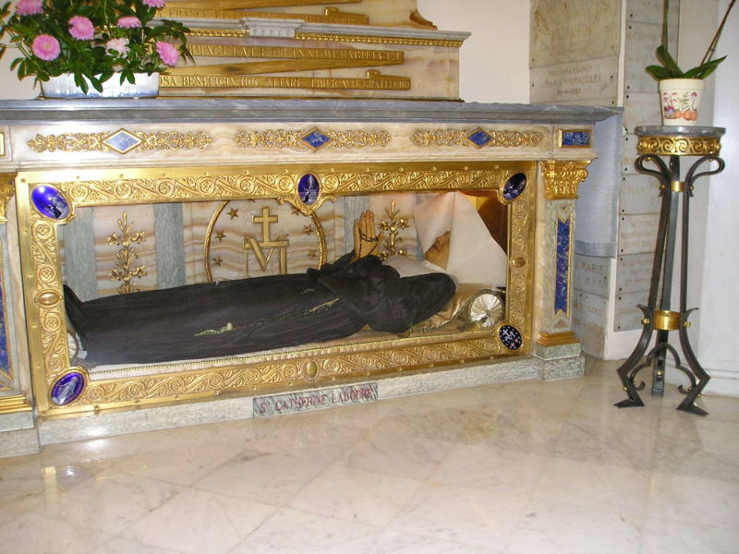
To be a mother is to provide help
1830 was 24 yrs before Immaculate Conception proclaimed in 1854
12 Stars
globe
<Crushed snake>
St. Catherine
Incorruptible
The School
of Mary

Slide 17
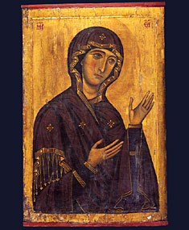
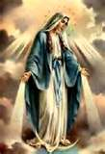
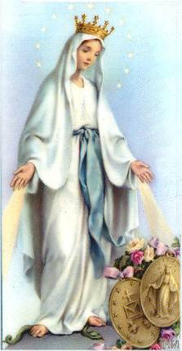

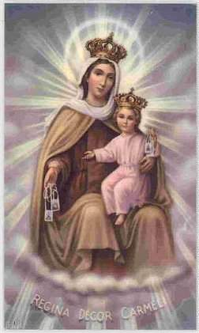
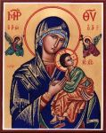
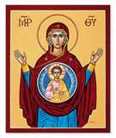

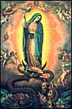

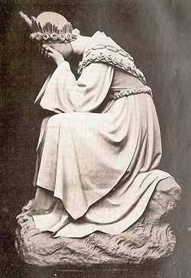
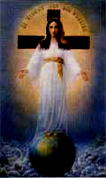

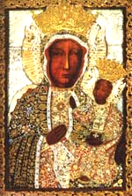

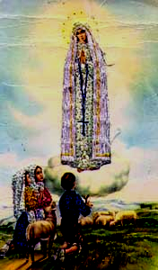

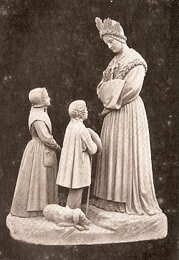
Our Lady Wants to Help Us Find Our Joy in Loving Christ. She thus teaches, prays, and bestows abundant graces.
1830
Karzan 1579
Our Lady of the Sign 13th century
Our Lady of Perpetual Help
1251
1531
Our Lady of the Rosary 1208
1858
LaSalette 1846
Black Madonna
1917 Fatima

Slide 18
Our Lady also helps the Church retain its true nature.
Our Lady embodies what it means to be Church:
  Joseph Cardinal Ratzinger: “. . . The Church learns concretely what she is and is meant to be by looking at Mary. Mary is her mirror, the pure measure of her being, because Mary is wholly within the measure of Christ and of God, is through and through his habituation. And what other reason could the ecclesia have for existing than to become a dwelling for God in the world?” Mary: The Church at The Source p. 66
Love of Our Lady secures the heart of the faithful.
  Ratzinger: “In the Church’s piety, Mary appears, so to speak, as the living Veronica’s veil, as an icon of Christ that brings him into the presence of man’s heart, translates Christ’s image into the heart’s vision, and thus makes it intelligible.” Mary p. 35
  “Only the Marian dimension secures the place of affectivity in faith and thus ensures a fully human correspondence to the reality of the incarnate Logos.” Mary p. 27
  Without the heart, there is no purification of epistemology (p. 27 in Mary)

Slide 19
Our Lady Also Helps Us
By Modeling The Christian Life
“’My soul magnifies the Lord.’ . . . To magnify the Lord means to give him room so that he may be more present in the world. It means to become more truly what we are: not a self-enclosed monad that displays nothing but itself, but God’s image. It means . . . To become truly human by pointing exclusively to him.” Ratzinger, Mary: The Church at the Source
“Mary hears in the very depths of her heart, so that she truly interiorizes the Word and can give it to the world in a new way.” Ratzinger p. 72.
Mary’s femininity that enabled her to be responsive to God helps us understand human freedom to be an empowerment for love.
Christians must reciprocate the love of Christ. “[A]ll human beings—both women and men—are called through the Church, to be the “Bride” of Christ . . . In the way, “being the bride,” and thus the “feminine” element, becomes a symbol of all that is “human” . . . as members of the Church, men too are included in the concept of “Bride.” . . . In the Church every human being---male and female---is the “Bride,” in that he or she accepts the gift of the love of Christ . . . and seeks to respond to it with the gift of his or her own person.” John Paul II MD 25.

Slide 20
The Importance of Our Lady’s Femininity
Our Lady’s femininity enabled her to become God’s partner in saving the world, since salvation became possible through the consent of a woman. (see M.D. n. 11).
Luke “constructs a parallel between Abraham, the father of believers, and Mary, the mother of believers.” Ratzinger: 86-8
“Mariology demonstrates that the doctrine of grace does not revoke creation; rather, it is the definitive Yes to creation. In this way, Mariology guarantees the ontological independence of Creation. . . . Mary is the believing other whom God calls. As such, she represents the creation, which is called to respond to God, and the freedom of the creature, which does not lose its integrity in love but attains completion therein.” Ratzinger, p. 31-2.

Slide 21
Our Lady’s femininity thus models the proper response to Christ, the Bridegroom.
It thus also models the essence of the Church, the Bride of Christ
The complementarity of the bridegroom and bride models the Trinity wherein distinction is not inequality and love is pure self-giving.
Heterosexuality thus models the equality and the complementarity of the sexes, namely, that male and female were made for imaging God through self-giving love. As John Paul II put it:* “Man becomes the image of God not so much in the moment of solitude as in the moment of communion. . . . [as] an image of the inscrutable divine communion of persons.” (*General Audience 14 Nov. 1979)

Slide 22
Our Lady’s Femininity Helps Us Understand
The Importance of Femininity and Human Biology for Anthropology
But first the problem: The feminine has disappeared from anthropology due to a seeking to be like God through an emancipation from the body. (Ratzinger p. 32)
Emancipation treats the body as “a trifle and a thing, and his ‘liberation’ turns out to be his degradation to an object of production. Whenever biology is subtracted from humanity, humanity itself is negated. Thus, the question of the legitimacy of maleness as such and of femaleness as such has high stakes: nothing less than the reality of the creature.” Ratzinger p. 33
“Since the biological determinateness of humanity is least possible to hide in motherhood, an emancipation that negates bios is a particular aggression against the woman. It is the denial of her right to be a woman.” Ratzinger p. 33

Slide 23
The Salvation Role of the Virgin Mother
Reveals the Truth about Femininity ---- and Human Biology
For---in the Virgin Mother---biology is also theology.
  In the words of Ratzinger (p. 33): “And the Woman in whom the ‘biological’ is ‘theological’---that is, motherhood of God.”
“Mary’s virginity, no less than her maternity, confirms that the ‘biological’ is human, that the whole man stands before God . . . It is no accident that virginity---although as a form of life it is also possible, and intended for, the man---is first patterned on the woman, the true keeper of the seal of creation, and has its normative, plenary form---which the man can, so to say, only imitate—in her.” Ratzinger p. 33

Slide 24



So how does the Blessed Virgin Mary Model Femininity?
By modeling biological motherhood
By modeling the spiritual motherhood of virgins
By modeling a love that is eager to help
By modeling faith as trust in Christ and His Church
By modeling hope as joyful confidence
By modeling the Church
By modeling the complementarity and indispensability of the sexes
By modeling the importance of human biology.
By modeling that evil is to be battled
through honesty, prayer, sacrifice,
and Christ-centered love

Slide 25
For us women to take Our Lady as our model is to embrace our femininity and, thereby, to embrace the complementarity of the sexes and our own maternity whether biological or spiritual.
To embrace our femininity is to care about others and to fight for their proper acknowledgment as spiritual and biological beings within our professions and our homes. It is to make the world more humane and more kind. It is to use Our Lady’s tools of truth, love, and prayer.
To embrace the complementarity of the sexes is to follow Our Lady’s example and turn to Christ and His Eucharistic Church for the assistance that not only cannot fail against evil but also that brings eternal joy.
To embrace our maternity is to dedicate ourselves to denying the prizes sought by the evil spirits and to attaining Our Lady’s help in acquiring the graces of the One who has conquered evil and embodied heaven’s love, namely, Christ.

Slide 26
In Evangelium Vitae, John Paul II explains that there is need for a new feminism that fights the culture of death through a love willing to suffer and to oppose abortion, contraception, and euthanasia.

Slide 27






Our Lady’s Femininity: A New Model or Exemplary Model? Both.
The new model is a Christ-centered spiritual motherhood; the exemplary model is to bring love into the world at all places and at all times.
As John Paul II pointed out, the feminine genius for love is needed everywhere

Slide 28
Recommended Readings
John Paul II, Theotokos Woman, Mother, Disciple: A Catechesis on Mary, Mother of God. Pauline Books and Media. 2000.
John Paul II, Mulieris Dignitatem. On the Vocation and Dignity of Women.
Joseph Cardinal Ratzinger, Mary: The Church at the Source. Transl. Adrian Walker, Ignatius Press, 2005; Johannes Verlag, 1997
Catholic Encyclopedia on-line

